Slide 1


Exception Handling

Slide 2


Overview
Unstructured Exception Handling
The Error Object
The On Error Go To Statement
Resume and Resume Next
The Error Statement
Creating Custom Exceptions in .NET
Use of Custom Exceptions
Custom Exceptions Naming Guideline
Guidelines for Exceptions
Best Practices for Handling Exceptions
What is Exception?
Why should we catch exceptions ?
'Exception' and 'Error' ?
The different kinds of exceptions
Namespace
Some System/Runtime Exceptions
Exception Hierarchy
System.Exception class properties
What is Exception Handling?
Structured Exception Handling
try/catch Blocks
Multiple Catch Blocks
Finally Blocks
Throwing application exceptions

Slide 3


What is Exception?
An exception is an event that occurs during the execution of a program
It disrupts the normal flow of instructions during the execution of a program.
An exception is an unexpected state during the execution of code.
It indicate an unusual state(a special condition) that needs to be handled.

Slide 4

Why should we catch exceptions ?
To make your program robust and reliable.
And it is vital for ensuring the quality of your code .
A good programmer is someone who never introduce bad code in his projects
For example:
Why should you use a helmet when you ride a bike ? To protect your head from crashing when there is an accident, right ? Just like that, exception handling will protect your application from crashing.

Slide 5

Why should we catch exceptions ?
If an exception is not 'handled' in code
The application will crash and user will see an ugly message.
Instead, you can catch the exception, log the errors and show a friendly message to the user.

Slide 6
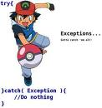

'Exception' and 'Error' ?
When an error interrupts the flow, the program tries to find an exception handler
A block of code that tells it how to react
Which will help it resume the flow.
An error is the event; an exception is the object that the event creates.

Slide 7
The different kinds of exceptions
System(runtime) exceptions
Application exceptions.
The difference between ApplicationException and SystemException
SystemExceptions are thrown by the CLR
ApplicationExceptions are thrown by Applications.
Application Exception is something that we throw from our program using "throw" clause.
System exception is those are thrown by the system at run time
Notes:
Application Exception is something that we throw from our program using "throw" clause, where as a system exception is those are thrown by the system at run time, for example, null-pointer. You dont need to throw a NullPointerException. You just need to do an operation(for example, call a method of a null object) with a null object, the system will throw it for you.

Slide 8
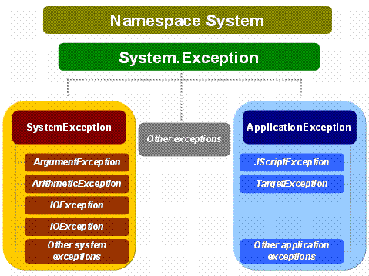
Namespace
System.Exception is the base class for all exceptions in C#.
Several exception classes inherit from this class including ApplicationException and SystemException.

Slide 9




Some System/Runtime Exceptions
OutOfMemoryException
NullReferenceException
InvalidCastException
ArrayTypeMismatchException
IndexOutOfRangeException
Arithmetic Exception
DivideByZeroException
OverFlowException

Slide 10

Exception Hierarchy
System.Exception is the base class for all exceptions in C#.

Slide 11
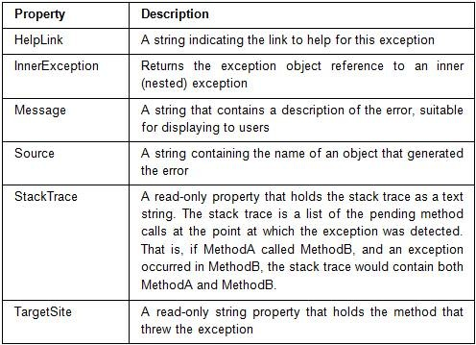
System.Exception class properties
Exception class contains a number of properties to make error management easy.
Exception object contains detailed information about an error, like:
To deal with error easier.

Slide 12
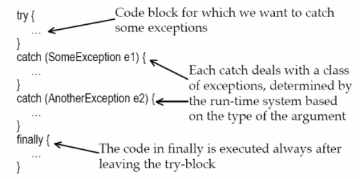

What is Exception Handling?
“Exception handling" means interpreting and reacting to the exceptions created by errors.
Exception handling is an in built mechanism in .NET framework to detect and handle run time errors.
Exception handling is achieved using the Try - Catch - Finally block

Slide 13
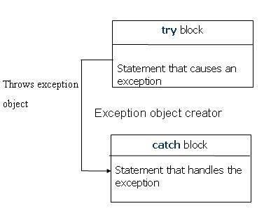
Exception Handling
Structured exception handling tests specific pieces of the code when exception occurs.
The Try...Catch...Finally control structure is fundamental to structured exception handling.
It Reacts differently based on the type of thrown exception.

Slide 14
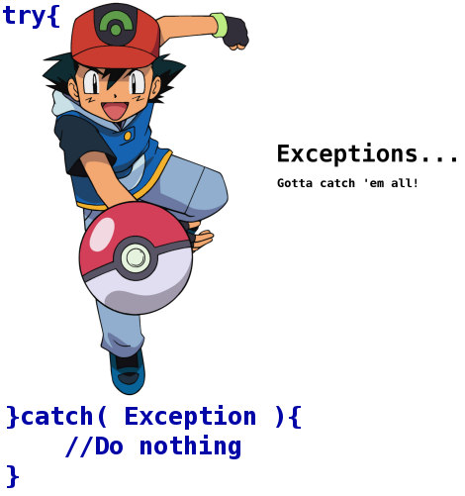
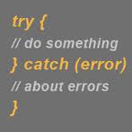
try/catch Blocks
When exceptions are thrown, It must be handled
This is done by
A try block followed by a catch block where you handle the exception.
Code that could throw an exception is put in the try block
And an exception handling code goes in the catch block.

Slide 15

Example:
using System; using System.IO; class tryCatchDemo { static void Main(string[] args) { try { File.OpenRead("NonExistentFile"); } catch(Exception ex) { Console.WriteLine(ex.ToString()); } } }
If the file doesn't exist, a FileNotFoundException exception will be thrown and caught by the first catch block.

Slide 16
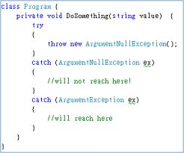

Multiple Catch Blocks
A try block can throw multiple exceptions, which can handle by using multiple catch blocks.

Slide 17
Format-Multiple Catch Blocks
try { //Code that might generate error } catch(Exception error) { //Code that handle errors occurred in try block //Note: It is most specific error we are trying to catch } catch(Exception error) { //Code that handle errors occurred in try block //Note: It is not specific error in hierarchy } catch(Exception error) { //Code that handle errors occurred in try block //Note: It is least specific error in hierarchy }

Slide 18
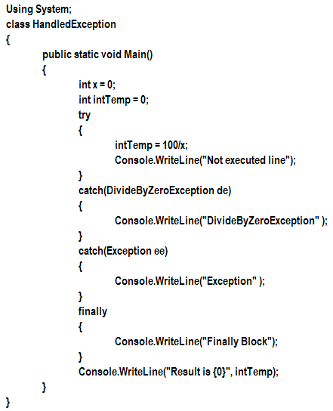
Example:

Slide 19
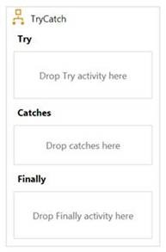
Finally Blocks
Finally Block contains the code that always executes, whether or not any exception occurs.
When to use finally block ?
A code fragment that must be executed regardless of exception.
Cleaning up resources such as closing file objects, releasing database connections etc.
Only One finally block is associated with try block.
Note –
Finally block executes even if there is no exception thrown

Slide 20
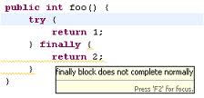
Finally Blocks
finally block must appear after all the catch block.
If there is a transfer control statement such as goto, break or continue in either try or catch block the transfer happens only after the code in the finally block is executed.
If you use transfer control statement in finally block, you will receive compile time error.

Slide 21
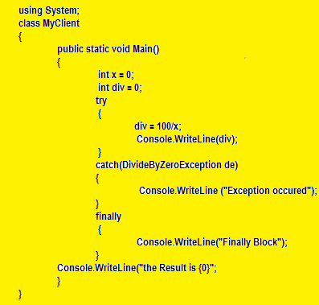
Example

Slide 22

Throwing application exceptions
The throw statement is used to signal the occurrence of an anomalous situation (exception) during the program execution.
It is preferable to raise or throw exceptions explicitly when error conditions occur
Allow exceptions to be captured by a try / catch / finally block or by the C# runtime system.

Slide 23
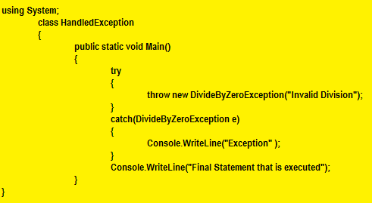
Throwing Exception - Example.

Slide 24
Creating Custom Exceptions in .NET
.NET framework contains all kinds of exception types which are sufficient in most cases
It make sense of define custom exceptions in your own applications.
They can greatly simplify and improve the error handling and thus increase the overall code quality.
Custom exception you create needs to derive from the System.Exception class.

Slide 25

Creating Custom Exceptions in .NET
Minimal Exceptions Types
A new custom exception class needs to have is a name.
Example: Let’s say you are designing the login mechanism for a database application and as part of this job you need to create a custom exception which is thrown if a login attempt fails.
A good name for such an exception would be LoginFailedException.
An absolute minimum implementation in C# then looks like:

Slide 26
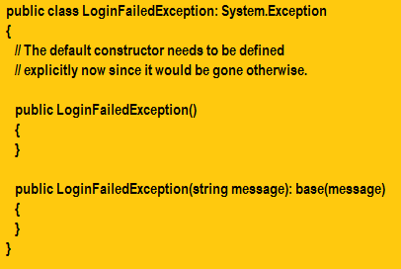
Creating Custom Exceptions in .NET

Slide 27
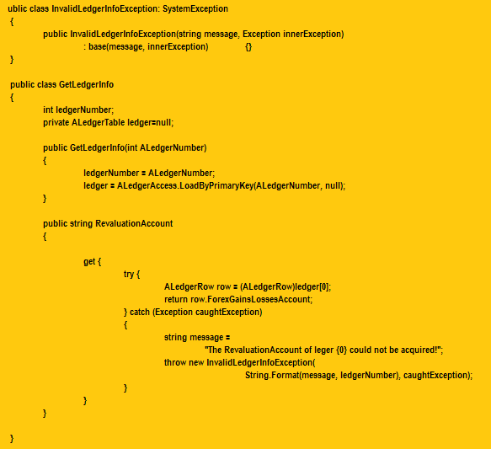
Example

Slide 28

Use of Custom Exceptions
They are useful for several reasons:
Their Name can tell much more about an Exception situation than a built-in Exception of the .NET Framework
They can contain arbitrary additional data
It is possible to create custom Exceptions that themselves derive from another Custom Exception
Exceptions with customized messages.
InnerExceptions, you can also track back the original error message.

Slide 29
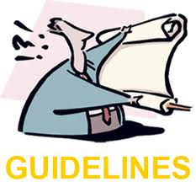
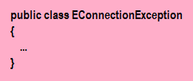
Custom Exceptions Naming Guideline
Name Exceptions with nouns or noun phrases.
Use Pascal Casing.
Name prefix: 'E' (stands for Exception).
Name suffix: 'Exception'. (The suffix is a recommended convention of Microsoft and considered good style by many C# programmers.)

Slide 30
Guidelines for Exceptions
Do not handle errors by catching non-specific exceptions, such as System.Exception, System.SystemException, and so on, in framework code.
Should catch only those exceptions that you can legitimately handle.
Should catch only those exceptions that you can recover from.
Catching exceptions that you cannot legitimately handle hides critical debugging information.
Do prefer using an empty throw when catching and re-throwing an exception.

Slide 31
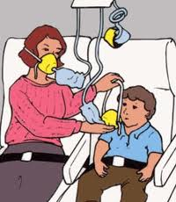
Defensive Programming
Defensive programming is a technique that makes programs more robust to unexpected events .
Less program "crashes" at run time
It increases the quality of software.
Exception handling can make defensive programming easier.
Defensive Programming is the concept of avoiding the exceptional situations to occur, even before it can occur, and exception handling is about handling an exception after it has happened,
Exceptions cannot be avoided some times.
Validating a user input,
numeral check before performing an arithmetic calculation is an example for Defensive Programming.

Slide 32
Defensive Programming Strategies
Check for Nulls
Trying to use a null object in code will result in a NullReferenceException
Check Object State
The current state of an object may prevent certain methods from being called on it.
For example, attempting to call the Close method on a connection that is already closed will throw an InvalidOperationException
Check Your Arguments
Many methods and constructors require arguments to be non-null,in a certain format, or within a range of acceptable values.
For example, attempting to create a DateTime of February 30, 2009 will result in an ArgumentOutOfRangeException, because February doesn’t have 30 days.

Slide 33
Defensive Programming Strategies
Be Careful When Working with Arrays
Remember that the elements of an array are of a certain type and that arrays are always of a fixed length. Attempting to store an element of the wrong type in an array throws an ArrayTypeMismatchException.
Use Safe Casting
If you attempt to cast an object to a type with which it is not compatible,an InvalidCastException will result.
Use Safe Parsing
In .NET, value types expose Parse and TryParse methods, both of which convert a string representation of a value to an actual value of the type

Slide 34


Best Practices for Handling Exceptions
A well-designed set of error handling code blocks can make a program more robust and less prone to crashing the application
Know when to set up a try/catch block.
Use try/finally blocks around code that can potentially generate an exception and centralize your catch statements in one location.
End exception class names with the word "Exception".
In C# and the Managed Extensions for C++, use at least the three common constructors when creating your own exception classes.
Use grammatically correct error messages, including ending punctuation.

Slide 35

Discussion

Slide 36

Summary
By now, you should have a good understanding of what an exception is.
You can implement algorithms within try/catch blocks that handle exceptions.
you know how to clean up resources by implementing a finally block whose code is always executed before leaving a method.
Validate or restrict user input to reduce the likelihood of exceptions being thrown.
Devise defensive programming strategies to prevent your code from causing exceptions to be
thrown when appropriate.
In cases where truly exceptional circumstances may occur, or where programmatic error
checking is impractical, be prepared to handle the resulting exception as needed.

Slide 37


References
http://msdn.microsoft.com/en-us/library/1ah5wsex(v=vs.80).aspx
http://msdn.microsoft.com/en-us/library/ms173163.aspx
http://www.blackwasp.co.uk/CSharpThrowingExceptions.aspx
http://www.csharp-station.com/Tutorials/lesson15.aspx
http://www.c-sharpcorner.com/UploadFile/rajeshvs/ExceptionHandlinginCSharp11282005051444AM/ExceptionHandlinginCSharp.aspx
http://msdn.microsoft.com/en-us/library/aa719631(v=VS.71).aspx
http://msdn.microsoft.com/en-us/library/aa289505(v=VS.71).aspx

